Slide 1
National Material Capabilities and Nuclear Weapons
PLSC 31101 Data Project, Bryce Farabaugh

Slide 2

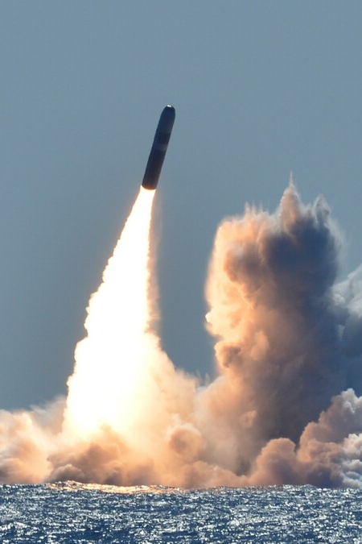

Research Question
What datasets include information about nuclear weapons, and how can they be improved?

Slide 3
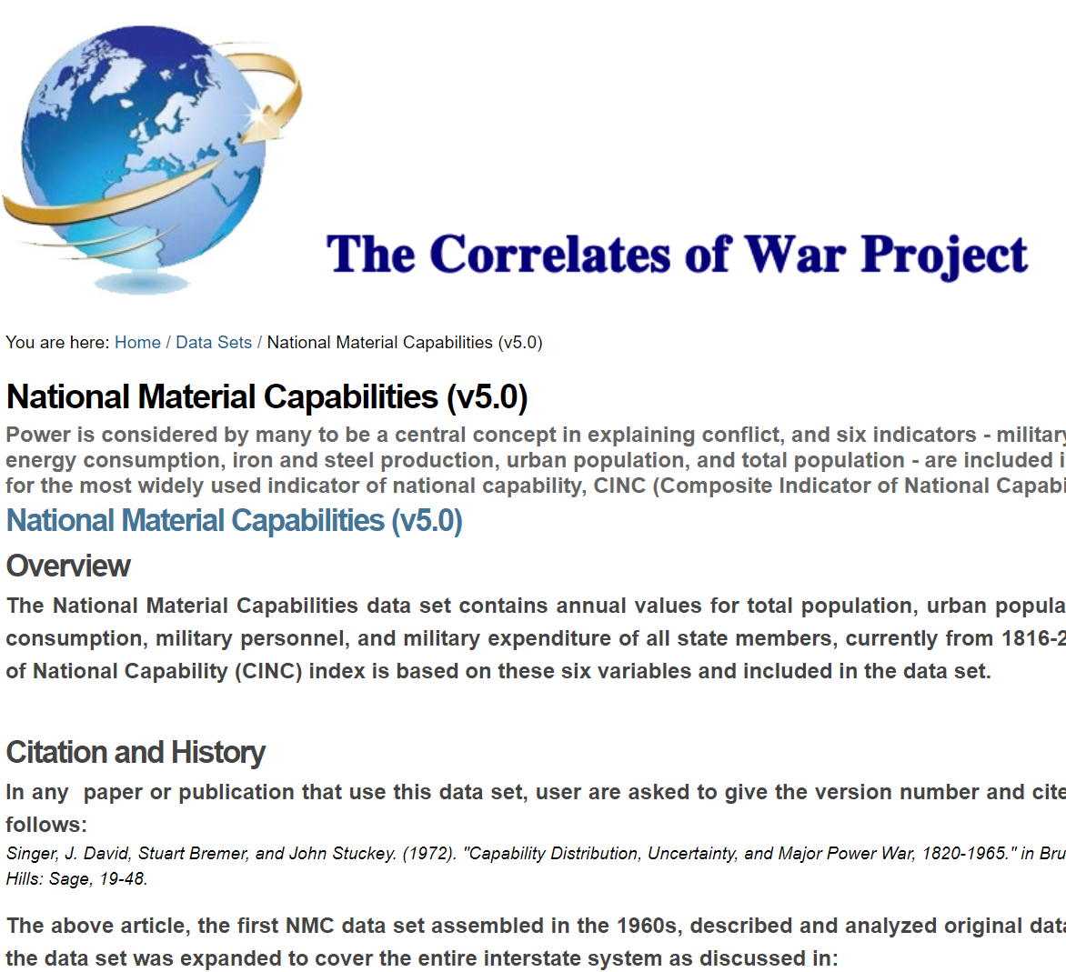
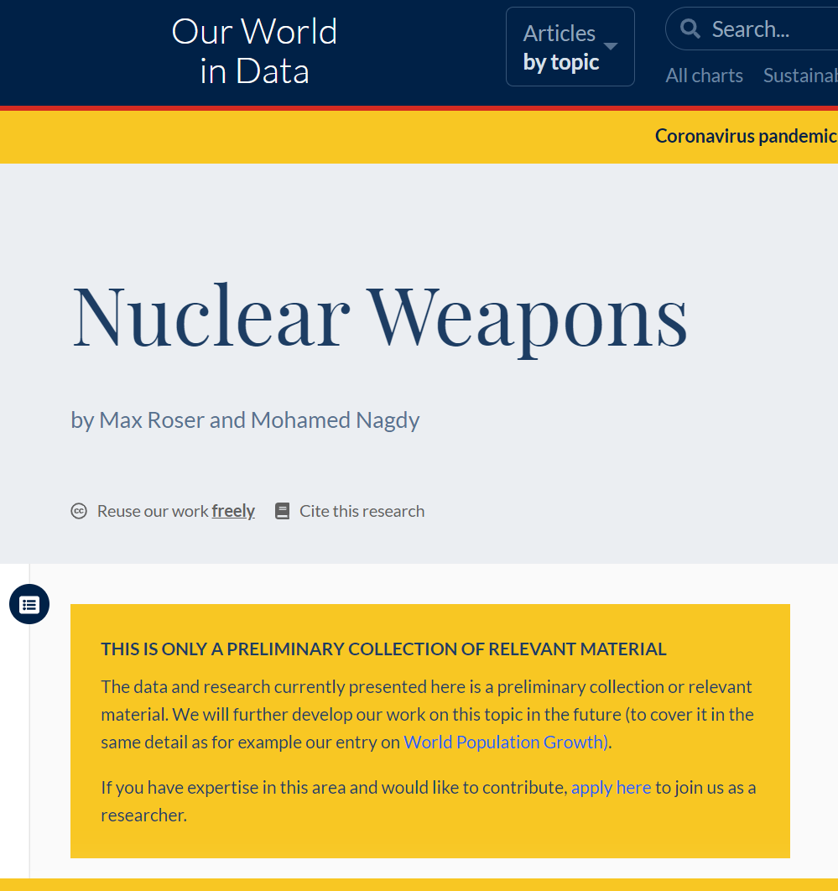
Existing Datasets

Slide 4

Steps
Download
Download datasets (“COW NMC”, “Number of nuclear warheads in the inventory of the nuclear powers, 1945 to 2014” & “Number of nuclear weapons tests, 1945 to 1998”)
Locate
Locate additional data (primarily various versions of the Nuclear Notebook
Add
Add new observations in R using add_row
Merge
Merge dataframes
Plot
Plot interesting data

Slide 5
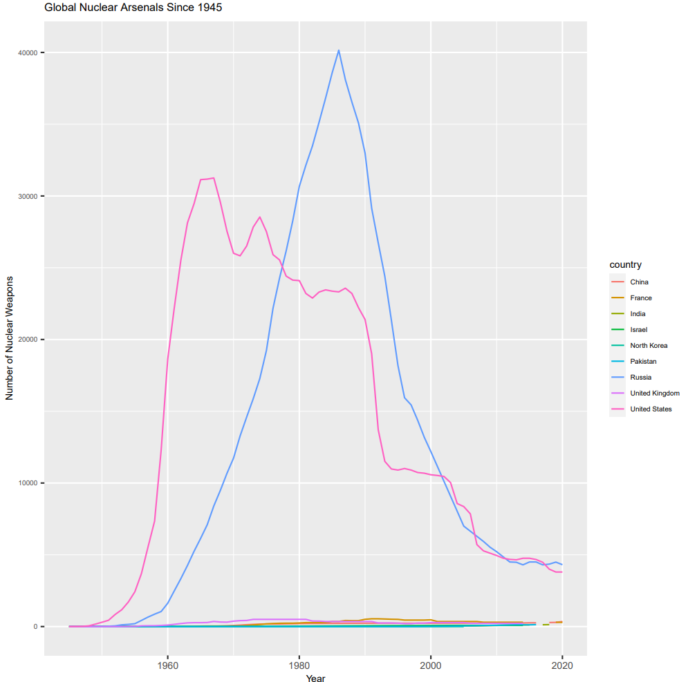
Results!

Slide 6
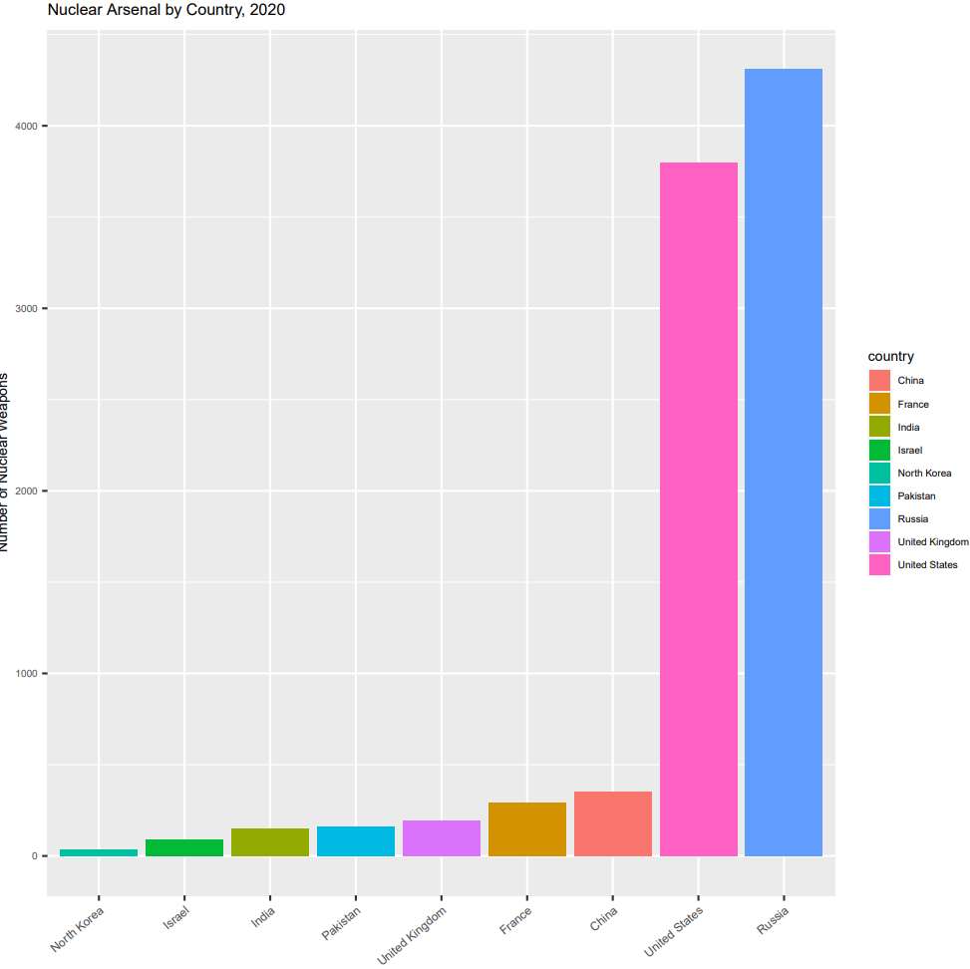

Slide 7
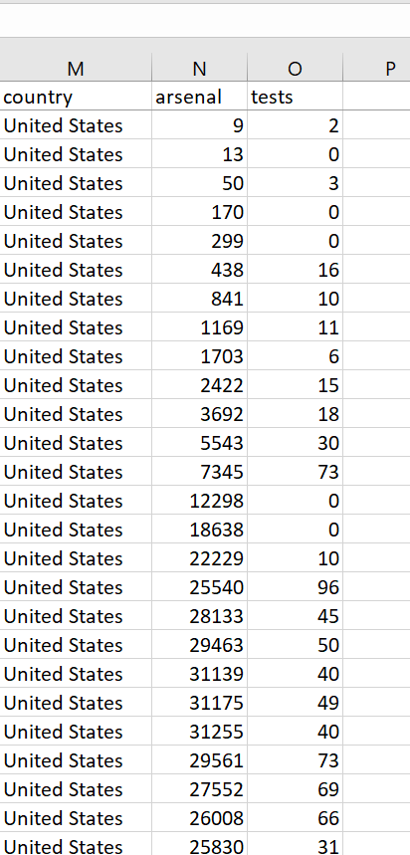
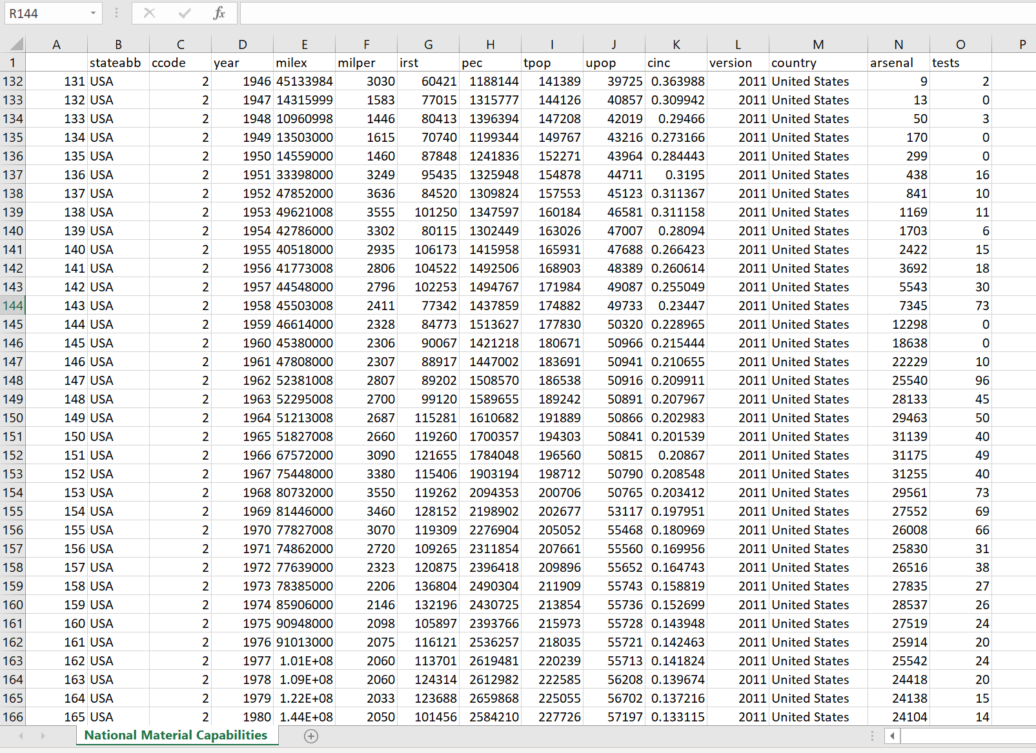


Slide 8
Further Research Questions
Are there any interesting observations that can be drawn from the NMC data with integrated nuclear weapon information?
How would nuclear weapons factor into the “Composite Index of National Capability”, a value meant to quantify “power”?
What other types of data would be useful in a dataset about nuclear weapon arsenals? Explosive yield, delivery platform, missile range, deployed vs. non-deployed, MIRVed vs. single-warhead missiles, etc?

